Slide 1


A study of the Deflection of 99942 Apophis from Earth
Carly VeNard, Dr. Davide Conte
Embry-Riddle Aeronautcial University
Dr. Anne Boettcher
2021 Arizona Space Grant Symposium

Slide 2
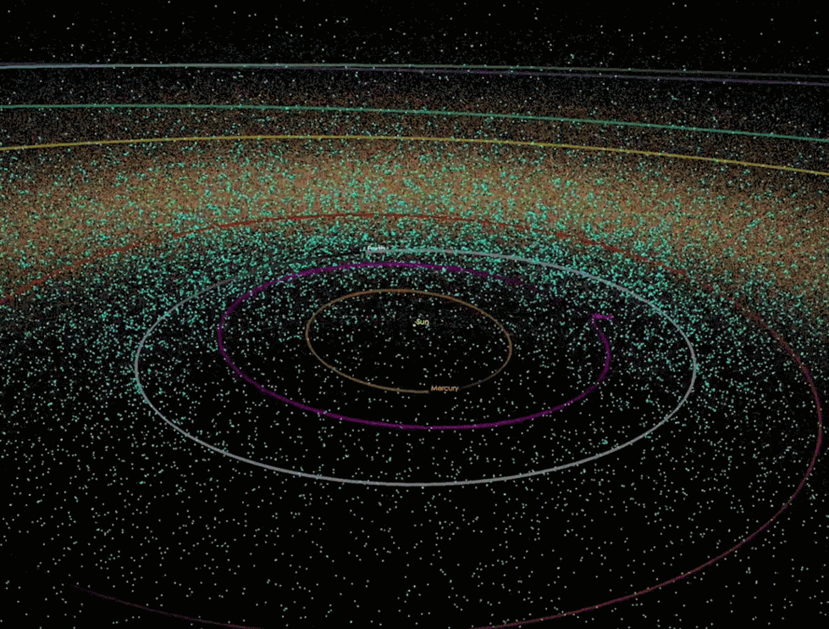
Over 2500 Near Earth Asteroids (NEAs) have been discovered, with more being discovered every day!

Slide 3
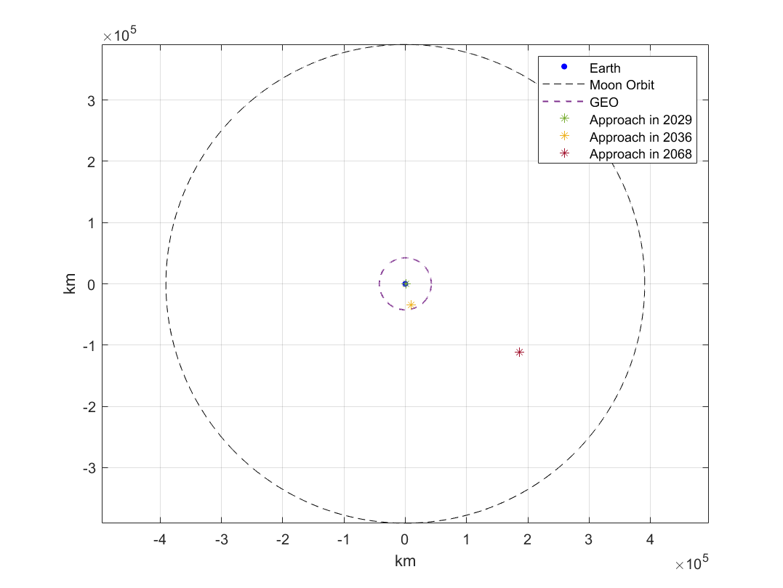
Apophis has been an asteroid of interest to scientists since its discovery due to its close approaches to Earth over the next 50 years

Slide 4
Several methods were considered to defer the orbit of Apophis
Nuclear Detonation
Ion beams
Kinematic Impactor

Slide 5
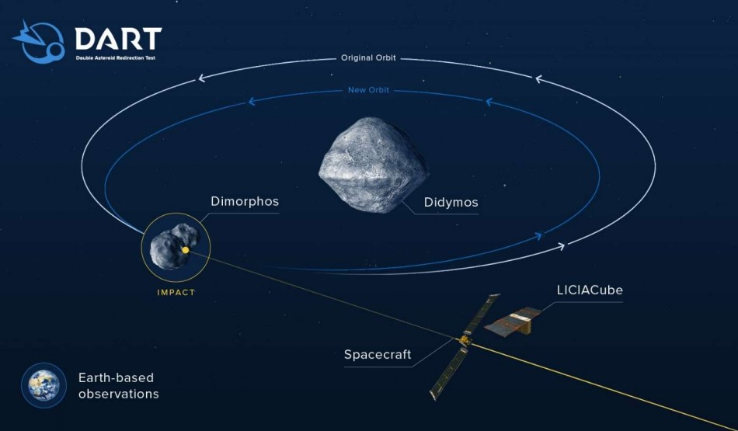
The Double Asteroid Redirection Test (DART) mission is the first mission in planetary defense

Slide 6
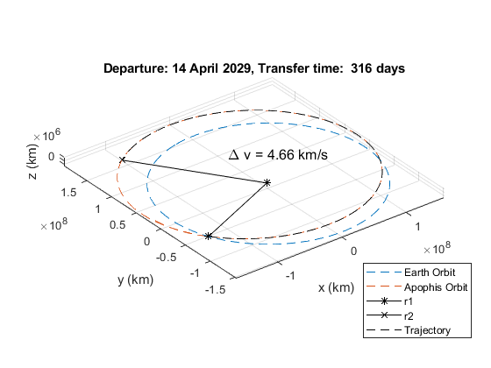
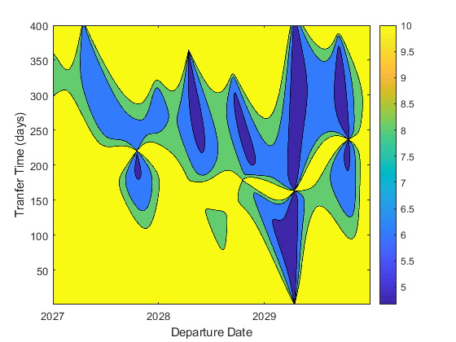
Analysis of Apophis Orbit took place to find the optimal transfer window

Slide 7
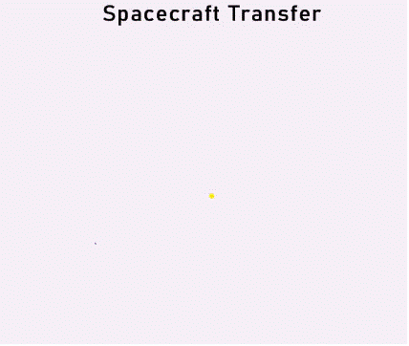
The same method used for the DART mission can be applied to the asteroid Apophis
- Apophis Orbit
Earth Orbit
Spacecraft

Slide 8
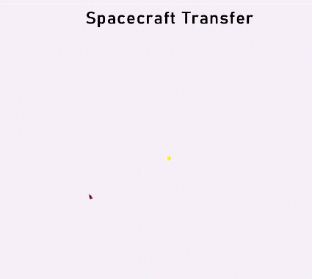
Future work will optimize Δv and deflection

Slide 9
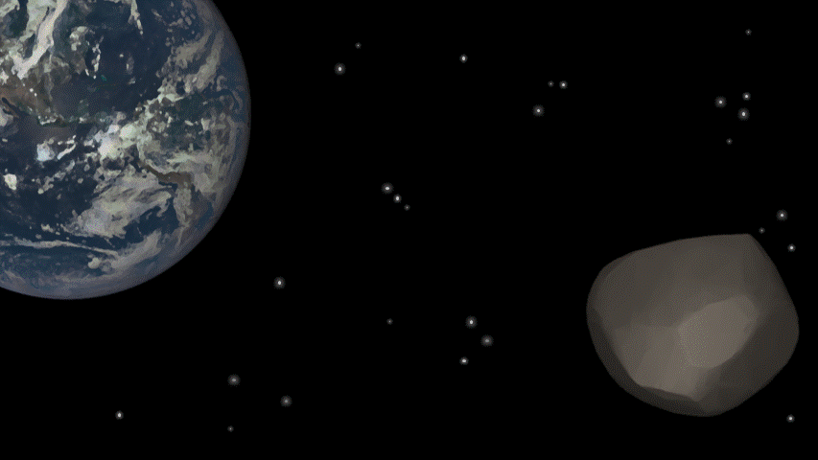
Deflection of Apophis greatly decreased the probability of impact in the future.
Questions?

